Slide 1

Introduction to hypothesis testing: one sample t-tests
R-Training Workshop
17th-26th 2016
At Pwani University
Dr. David Mburu (PhD)

Slide 2
Posits
Learnt how to summarise continuous data
Move on to
  testing prior beliefs about population means using sample means
  testing for differences in means for paired data

Slide 3

Hypothesis testing (1)
Have a belief that;
population mean = particular value
Design a study to collect data to test this
Estimate a mean value from a sample
Use this to test if sample data consistent with population mean = some value
4 keys stages to testing hypotheses

Slide 4


Stage 1: define hypothesis
We make two key statements to define
  null hypothesis
  alternative hypothesis
Null hypothesis:
  population mean = particular value
Alternative hypothesis:
  population mean ≠ particular value

Slide 5
Example
Sample mean birth weight in 141 babies was 3.01 with s.e. 0.04
Suppose prior to the study it was thought
  population mean was 3.25 kg
  μ₀ = 3.25
What are the null & alternative hypotheses?
H₀: μ = 3.25 vs H₁: μ ≠ 3.25

Slide 6
Stage 2: significance
State level of significance
  usually 5%
Two-sided test
  difference of the same size in either direction
Assume null hypothesis is true
Look for evidence in the sample data
  to accept or reject the null hypothesis

Slide 7
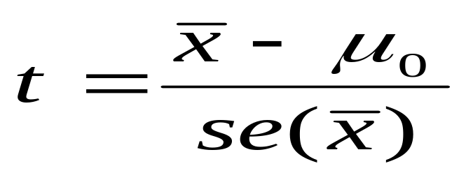
Stage 3: test statistic
1 sample t-test
Test statistic
  = (difference between sample mean & popul. mean) standard error of the sample mean
Degrees of freedom = no. of observations minus 1

Slide 8
Example
sample mean = 3.01
standard error (sample mean) = 0.04
population mean = 3.25
t = (3.01 – 3.25) = -6.00
  0.04
degrees of freedom = n – 1 = 141 - 1 = 140

Slide 9
Stage 4: p-value
To get p-value
  compare t to statistical tables or use R output
Interpretation of p-value
  p-value = probability of observing our data
  assuming that the null hypothesis is true
A low p-value implies
  low prob. of observing data if null hypothesis is true
  evidence to reject the null hypothesis
  In R, P_value<- pt(-6, df=(141-1))::::::::::[p<0.001]

Slide 10
Interpretation
p-value
= probability of observing our data assuming that the null hypothesis is true
= probability of observing our data given that the population mean birth weight is 3.25 kg
< 0.001
Conclude
  unlikely that we would get our sample mean if the population mean birth weight was really 3.25 kg
  have found strong evidence to suggest that the population mean ≠ 3.25 kg

Slide 11
Beware
A low p-value does not prove the alternative hypothesis:
it provides evidence to suggest it could be true
A high p-value does not prove the null hypothesis

Slide 12
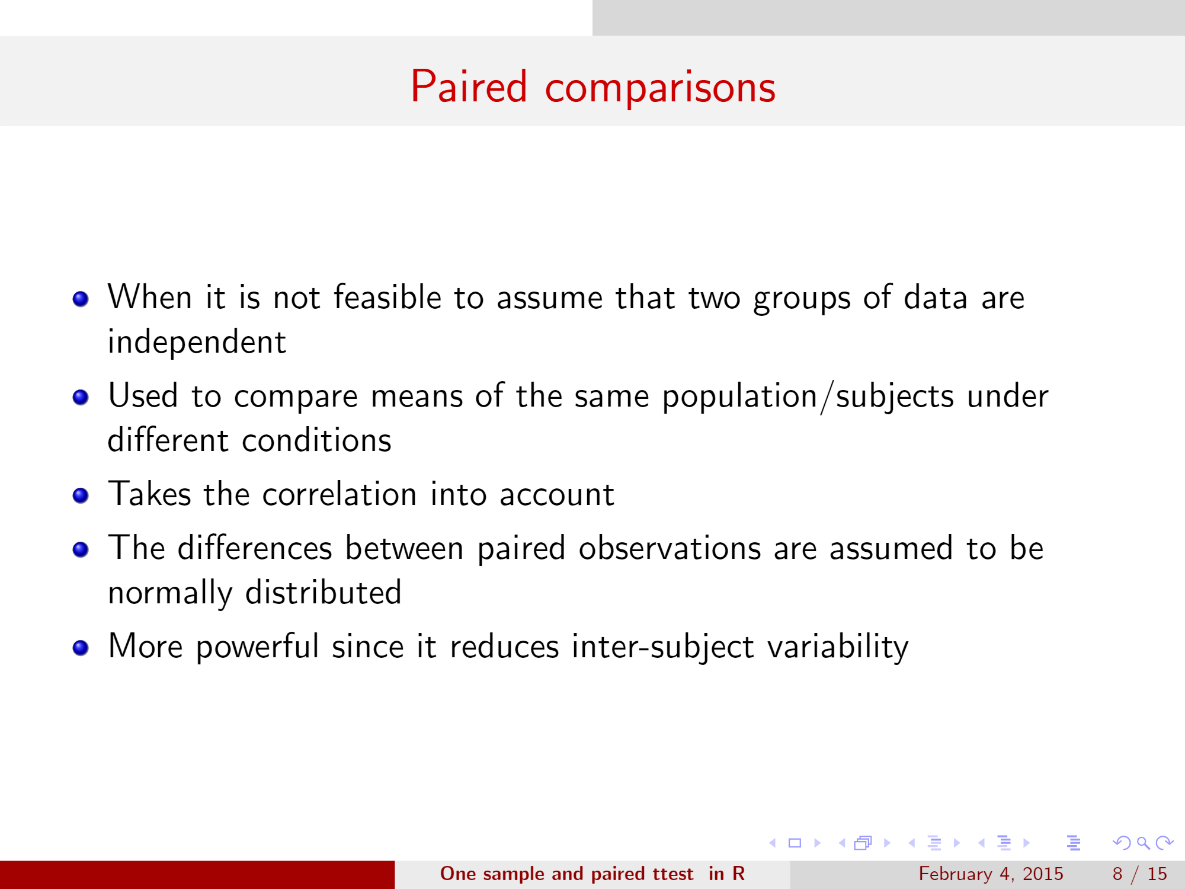

Slide 13
Examples
Pre- and –post scores for scholars receiving tutorials
Sunburns scores for two sunblock lotions; one applied to the individual right arm and the other on the left arm

Slide 14
One- sample t-test for paired data (1)
Weight measured in same babies
  at birth
  prior to leaving clinic
Q: mean weight at birth = mean weight on leaving clinic?
Birth
  mean birthweight in 122 babies = 3.03 kg
Leaving clinic
  mean birthweight in 122 babies = 3.07 kg

Slide 15
Paired Data (2)
What do we think looking at those 2 mean values?
Are the 2 sets of weights comparable?
What is our null hypothesis?
  H₀: mean at birth = mean on leaving
Equivalent to:
  H₀: mean difference in weights = 0

Slide 16
Paired data (3)
include 122 babies with 2 weight measurements
mean difference = difference between means
        = - 0.04
calculate s.e. of the differences in the weights
test statistic = mean difference / s.e.(mean difference)
t = - 0.04 / 0.01 = - 4.00
d.f. = 122 – 1 = 121

Slide 17

An example in R
A stimulus applied to 12 men to determine its effect on systolic blood pressure (BP) prior to and after application
BP prior:20,20,21,22,23,22,27,25,27,31,30,28
BP after:19,22,24,24,25,26,26,28,28,29,30,25
Hypothesis?
Is there significant effect on BP before and after application of the stimulus?

Slide 18

…in R?
BP_prior_Vector<-c(,,,,,,,,,,)
BP_after_Vector<-c(,,,,,,,,,,,)
Ttest_paired<-t.test(BP_prior_vector,BP_after_Vector,paired=TRUE)
Paired t-test,
data: BP_prior_Vector, BP_after_Vector

Slide 19
Comparing the means of 2 groups
Statistical inference is a tool to enable comparisons to be made.
A comparison of means makes assumptions about the groups being compared:
The two groups are measured in the same way.
The data are approximately normally distributed within each group
For the comparison of 2 means, the parameter we are estimating is the difference between the means.
To do this calculate the standard error of the difference.

Slide 20
Summary
Use one sample t-test
  Test if population mean = particular value
  Based on prior assumption about population mean
  Test if sample means measured on 2 occasions are equal
  More common than previous example
  Based on set of complete measurements

